Slide 1
Workshop 2: Flying into Python

Slide 2
Login to laptop
Choose your account with the number of the laptop
Password is ‘password’
If you are able to login charge your laptop and battery while waiting
Thank you!

Slide 3
Workshop Format
Packed with many hands-on coding breakout activities that needs your team to try, code and learn.
The activities are designed to prepare your team towards the Qualifier and Final Games curated by IMDA.
Your team never walk alone as instructors are always around to guide you on the activities. Please find them and consult them.
Activities are quizzes in NYTC Google Classroom Classworks. Every team must submit answers.
Your team needs at least one person to join NYTC 2025 Google Classroom. Have your team joined?
Some of activities are PLUS activity. PLUS activity are challenging but optional.

Slide 4
Workshop 2 Objectives
By the end of this workshop, students can control drones with python code by:
• Using and understanding Function in Python
• Using libraries to control drone
• Using variables to store drone’s data
• Applying if-else statements with drone’s data

Slide 5
Why Learn Python?
Python is widely used in AI, data science, web development, and robotics.
More flexible and powerful than block coding.
Helps solve real-world problems efficiently.
Used by professionals in the industry.

Slide 6
Block Coding vs. Python
Feature | Block Coding (e.g., Scratch) | Python (Text-Based Coding)
Interface | Drag-and-drop blocks | Typed code in text editor or Integrated Development Environment
Ease of Use | Beginner-friendly | Requires learning syntax
Flexibility | Limited to predefined blocks | Can create custom functions & libraries
Real-World Use | Mainly for learning | Used in professional applications

Slide 7
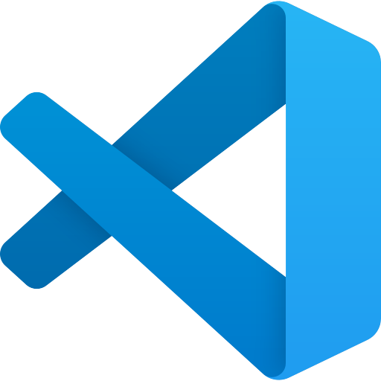
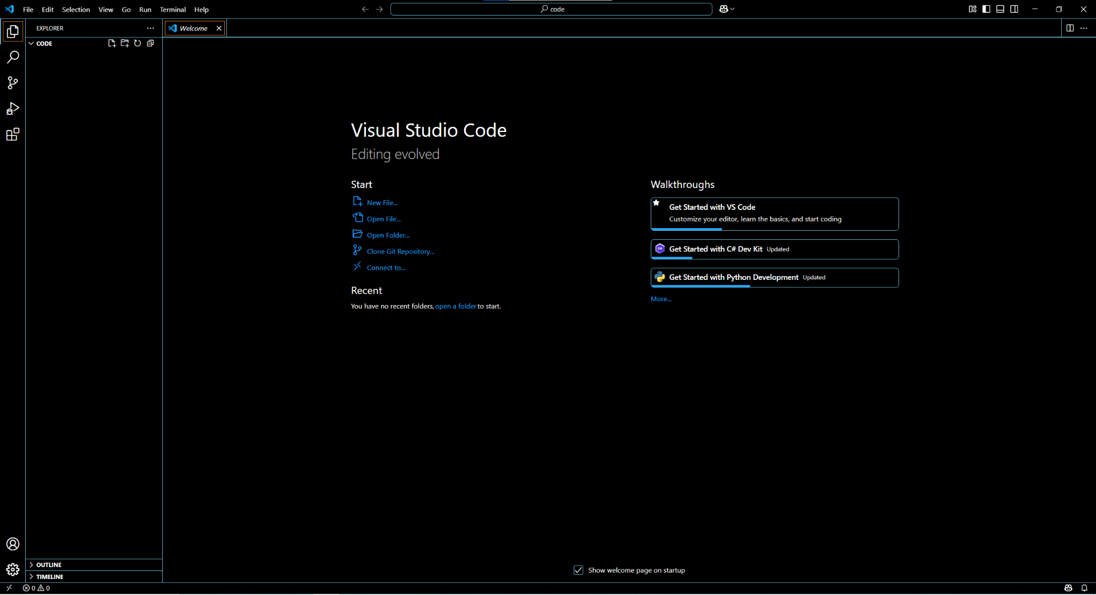
How to code in python -
Use Visual Studio Code
Ensure your laptop has Visual Studio Code
Open Visual Studio Code and do these:
Click Open Folder.
Select code folder in Desktop

Slide 8
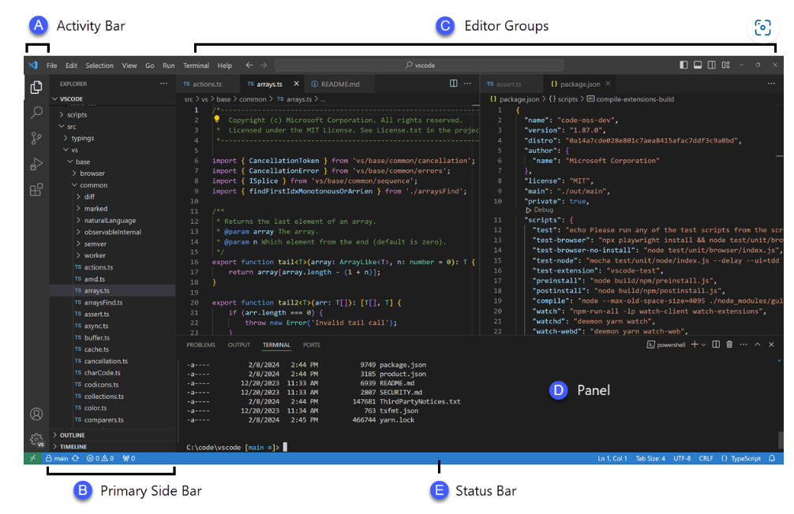
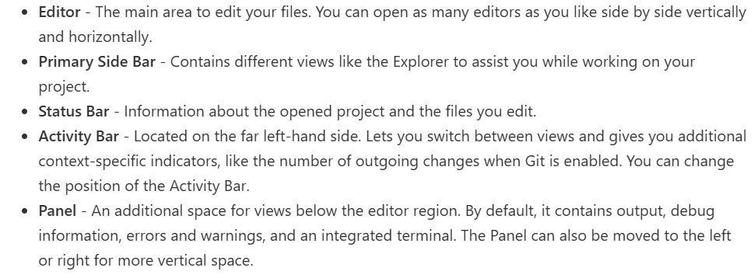
Know Visual Studio Code

Slide 9
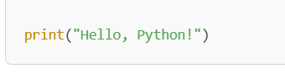
Create a Python File and Write your First Code
Click File > New File, then Save As → name it first_code.py.
Type the following code in Editor panel.

Slide 10
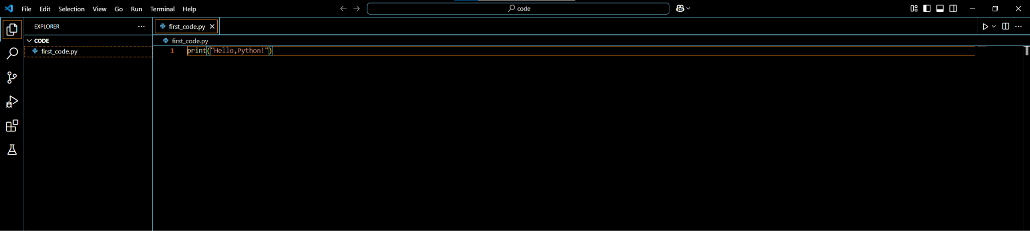
Quiz - What is the output? (15 mins)
Click on Run after you enter your code.
What do you see?
Provide your answer via NYTC 2025 Classroom->Classworks->Workshop 2 Assignment-> Using visual code to code section quiz

Slide 11
Understanding Functions in Python

Slide 12
What is a Function?
In block coding, you may have used custom blocks or procedures to group multiple instructions together. Instead of repeating the same set of blocks, you could create a "My Block" in Scratch or a function block in MakeCode.
In Python, a function works the same way—it is a reusable block of code that performs a specific task. Instead of dragging and dropping blocks, we write a function using text-based commands.
A function is a reusable block of code that performs a specific task.
Instead of writing the same code multiple times, we can define a function once and call it whenever needed.
Functions help keep our code organized, efficient, and easy to debug.

Slide 13
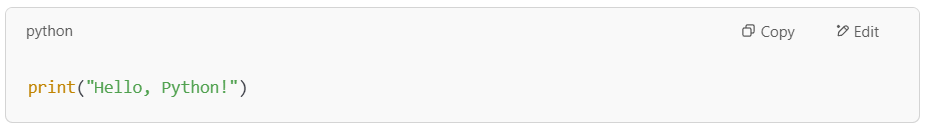
Relating Functions to the "Hello, Python!" Code
In the previous section, we wrote a simple Python program:
The print() function is a built-in function in Python.
It takes input (text in quotes) and displays it on the screen.

Slide 14
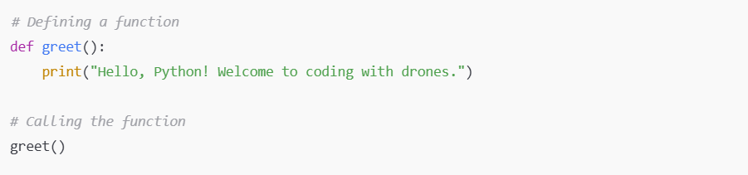
Defining and Calling a Function
How It Works:
def greet(): → Defines a function named greet.
Inside the function, print("Hello, Python! Welcome to coding with drones.") prints a message.
greet() → Calls the function and runs the code inside it.

Slide 15
Do Quiz Section 2 (30 mins)
There are two questions in Quiz Section 2. Please do all.

Slide 16
Python Libraries

Slide 17
Introduction to Python Libraries
In Python, a library is a collection of pre-written code that you can import into your program to perform certain tasks. Using libraries allows you to avoid reinventing the wheel and to save time by using functions already created by others.
The pyhula library provides functions that make it easy to control drones using Python. Instead of manually writing every line of code to control the drone, we can use the pre-built functions in the pyhula library to make the process simple.

Slide 18
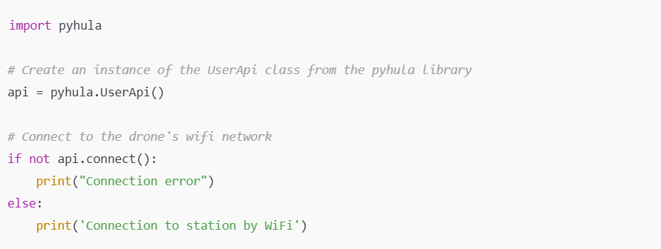
Connecting to the Drone with pyhula
Now, let's write code to connect to the drone and control it. Here’s how we do that with the pyhula library:
The pyhula.UserApi() creates an object that allows us to interact with the drone.
The api.connect() function tries to establish a Wi-Fi connection with the drone. If it fails, the program prints an error message. If successful, it prints a success message.
If your laptop’s wifi has not connected to the drone, it will not be successful when you run the code. MAKE SURE you turn on the drone and connect your laptop’s wifi to your drone before running the code.

Slide 19
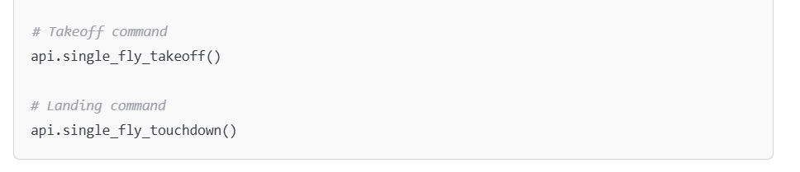
Taking Off and Landing the Drone
Once connected, we can control the drone. Below are the functions for takeoff and landing:
api.single_fly_takeoff() tells the drone to take off.
api.single_fly_touchdown() makes the drone land.
These functions come from the PyHula library and save you from having to write the complicated commands for controlling the drone’s movements manually.
There are many other functions in pyhula. Find out about the other functions in Hula_API_ENGLISH.pdf. This pdf is the most important document. It is available in NYTC 2025 Google Classroom Classworks.

Slide 20
Do Quiz Section 3 (30 mins)
There are two mandatory question and one optional question in Quiz Section 3.
Please do the two mandatory questions, and attempt the one optional question.

Slide 21
Variables and If-Else

Slide 22
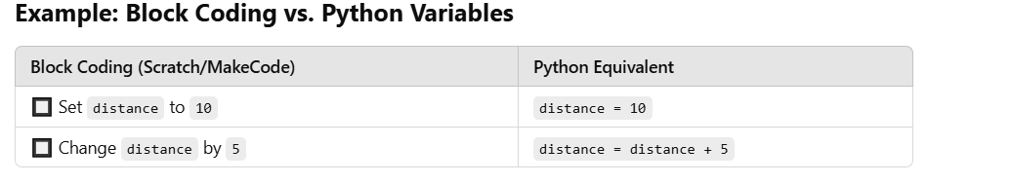
What is a Variable?
In block coding, you may have used a "Set Variable" block to store a value and use it later. For example, in Scratch, you might create a variable called score to keep track of points in a game:
Set score to 0
Change score by 1
In Python, a variable works the same way—it stores a value that can be used or changed later in the program. Instead of using blocks, we write variable names and assign values using the = sign.

Slide 23
Declaring Variables in Python
In Python, a variable is created when we assign a value to a name:
The variable distance now holds the value 10, and we can use it later in our program.

Slide 24
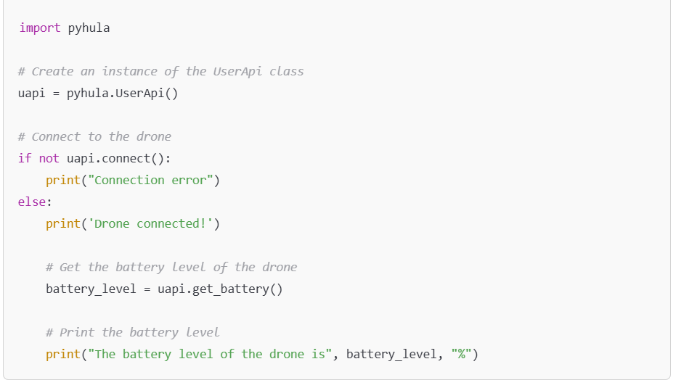
Using Variables to store the Drone’s battery level
Now, let's use a variable to store the battery of the drone using the uapi.get_battery() function.
Explanation:
We create a variable battery_level to store the value from uapi.get_battery().
This value is printed to the screen so we can see how much battery is remaining.
We can use battery_level later in the program to make decisions (e.g., whether the drone should take off).

Slide 25
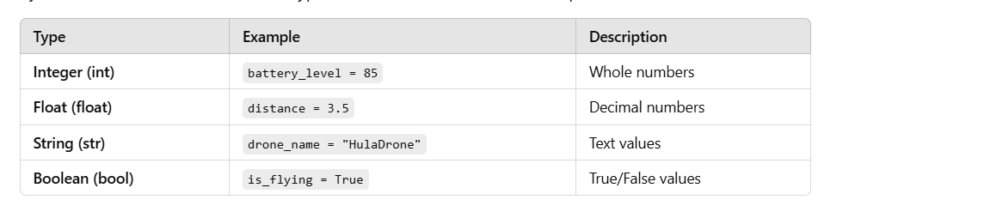
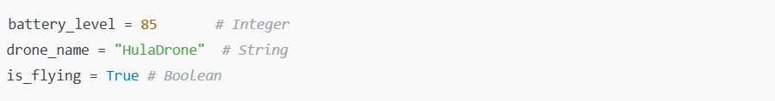
Types of Variables in Python
Python variables can store different types of values. Here are some examples:
Python automatically determines the type of variable based on the value assigned.
We can check the type of a variable using the type() function:

Slide 26
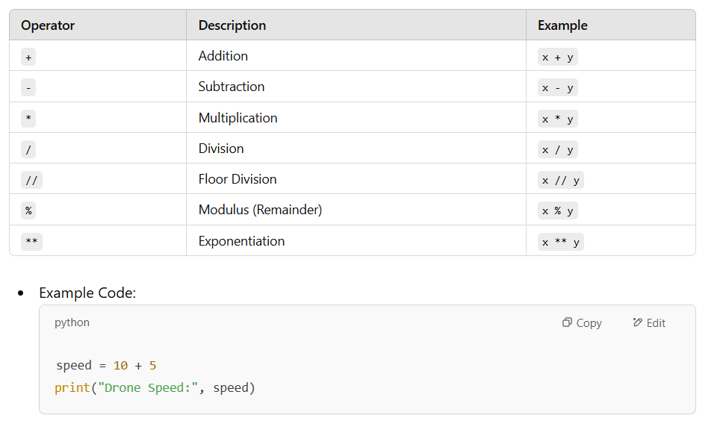
Arithmetic Operators
Like in block coding, you can perform arithmetic operations on variable of the same type. In python, you can do so:

Slide 27
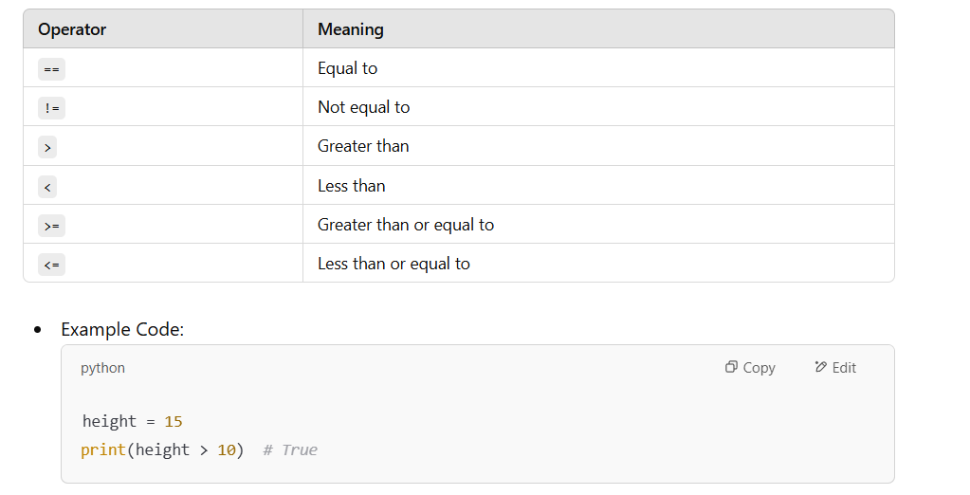
Comparison Operators
You can also compare values stored in two variables and get True or False, using these operators:

Slide 28
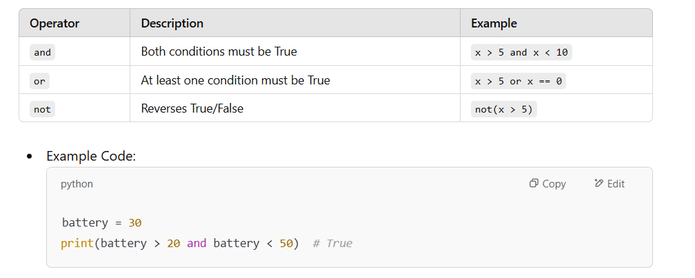
Logical Operators
Like in block coding, you can write codes to compare more than 2 or more TRUE/FALSE values with logical operators (AND, OR etc). In python, logical operators are written like these:

Slide 29
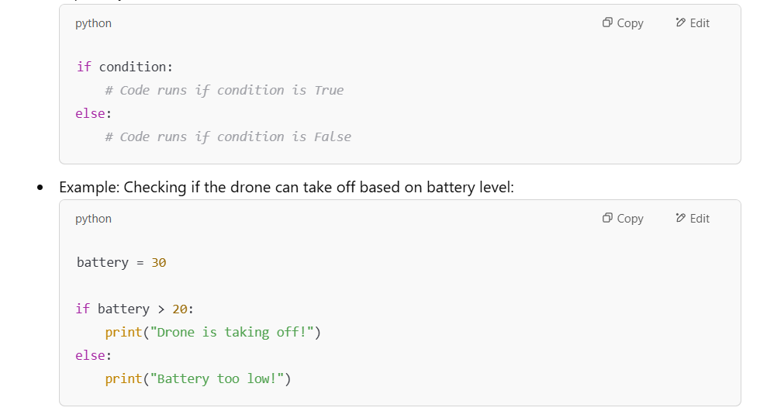
If-Else Statements
Python if-else syntax:

Slide 30
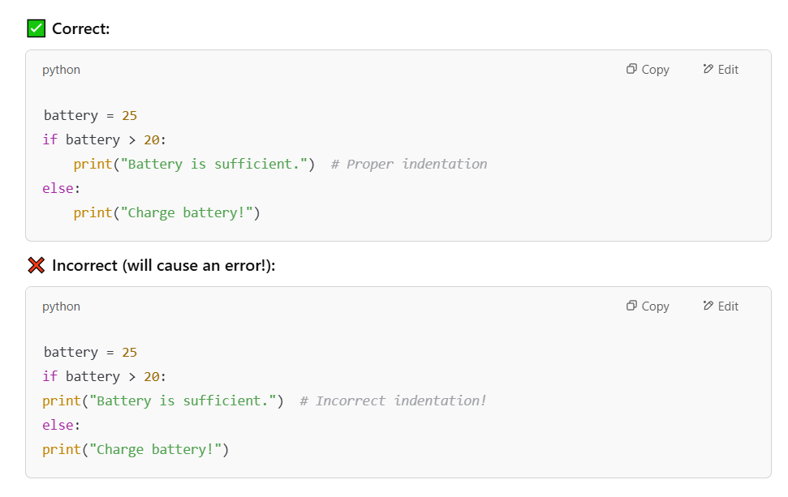
Importance of Identation
Python relies on indentation instead of brackets {} (used in other languages like Java or C++).
MUST carefully check your indentation when you code. WATCH OUT FOR highlights by Visual Studio Code on indentation warning.

Slide 31
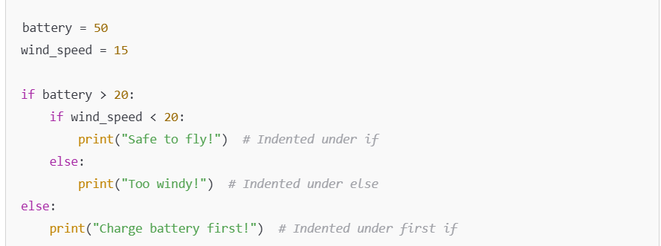
Nested If-Else and Identation

Slide 32
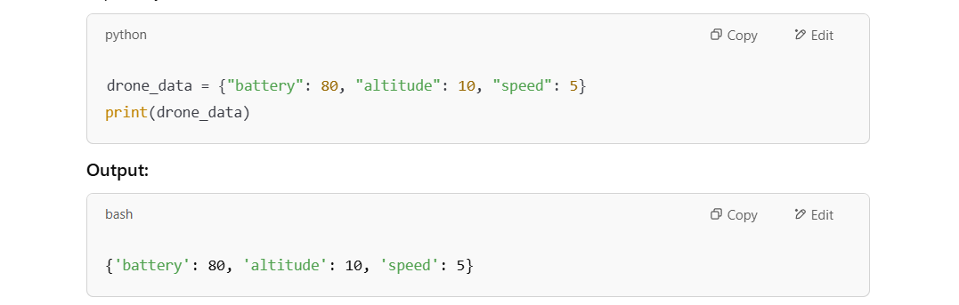
Python Dictionaries
Qn: "How do you store and organize data in block coding?" (e.g., lists, variables).
In python, there is something like labeled storage boxes which is called dictionary. Python dictionary store data as key-value pairs

Slide 33
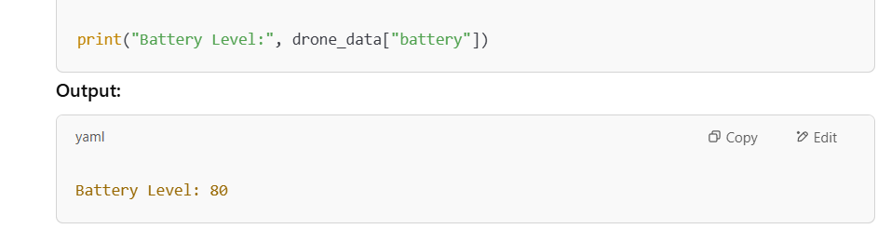
Accessing Dictionaries Value

Slide 34
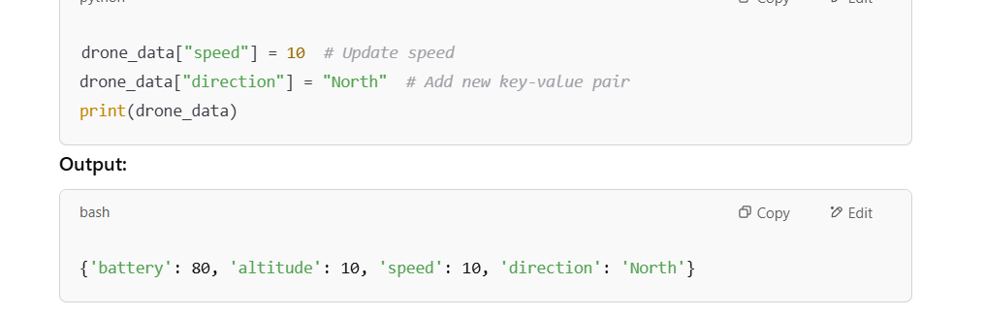
Modifying Dictionaries Value

Slide 35
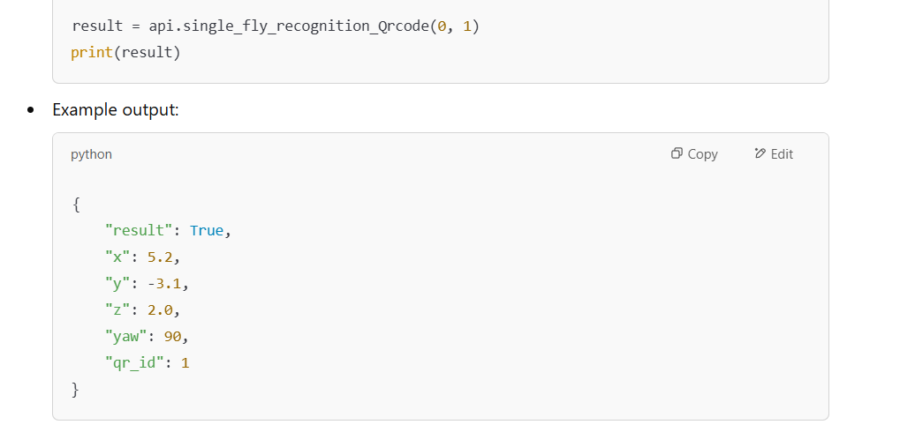
Using QR Recognition API
The drone has a function to recognize QR code and tell your program position of the QR code with respect to the drone.
It is single_fly_recognition_Qrcode(0,1) where 0 means to use downfacing optical flow camera, and 1 means to attempt to recognize QR code 1.

Slide 36
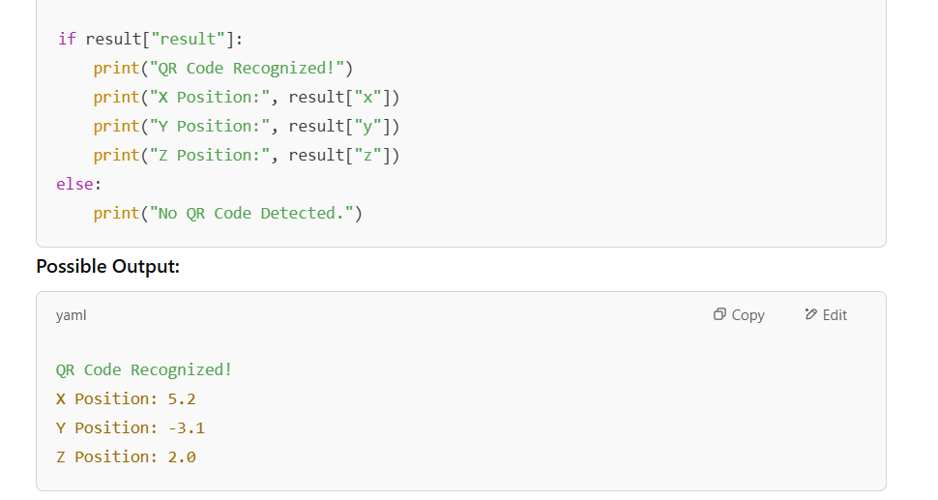
IF-else and QR Code Recognition
Sometimes the drone fails to detect QR code due to too far away. There is a need to if-else to check if there is detection before printing other value. Why?

Slide 37
Do Quiz Section 5 (90 mins)
Do the one question in Quiz Section 5.

Slide 38
Key Takeaways
Learn some python to control drone:
Use code editor to code python.
Use function to control drone movement.
Use variables and if-else together with sensors to detect height.
Use dictionary together with QR code detection.

Slide 39
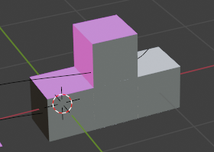
Practice in School Activity for Workshop 3 (Virtual)
Find 4 to 6 boxes or any other objects in your school that are of 60cm (width) x 60cm (breadth) x 30cm (height).
Stack the boxes to form a step-up triangle.
Code your drone to takeoff, fly to the areas that is above the surface indicated by the yellow arrow.
At each of the areas indicated by the yellow area, hover and determine height of that surface using TOF sensor or QR code. Print to console the height of the surfaces.
Last, fly to the area that is above the surface that is indicated by the red arrow. Land.
Some questions to experiment and try:
How to improve the speed to complete and yet able to determine the height?
How to improve the precision of the landing? Use QRcode? How?
What is your best timing?
What is the best height to fly?
What are pros and cons of using QR code or TOF to determine height.
Please try. The instructor will discuss this at workshop 3 (virtual). You are welcome to ask questions at the workshop or via google classroom.
If you have tried, record the video and publish the video to youtube as unlisted. Submit the link to show your success via the form before workshop 3. No prizes.

